Slide 1
DBMS La 1 Game Database
Done by:
Satvik A - 1NT19IS142
Amith P Kashyap - 1NT19IS018
Kalyan B - 1NT19IS067

Slide 2
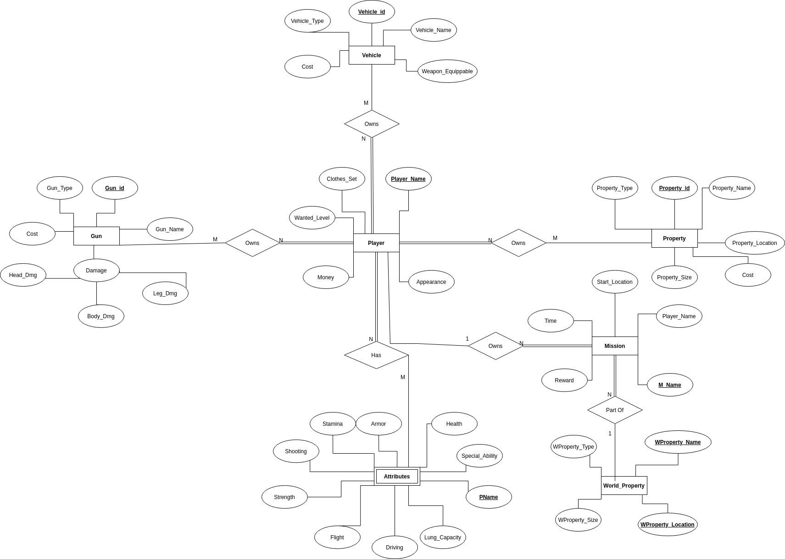

Slide 3
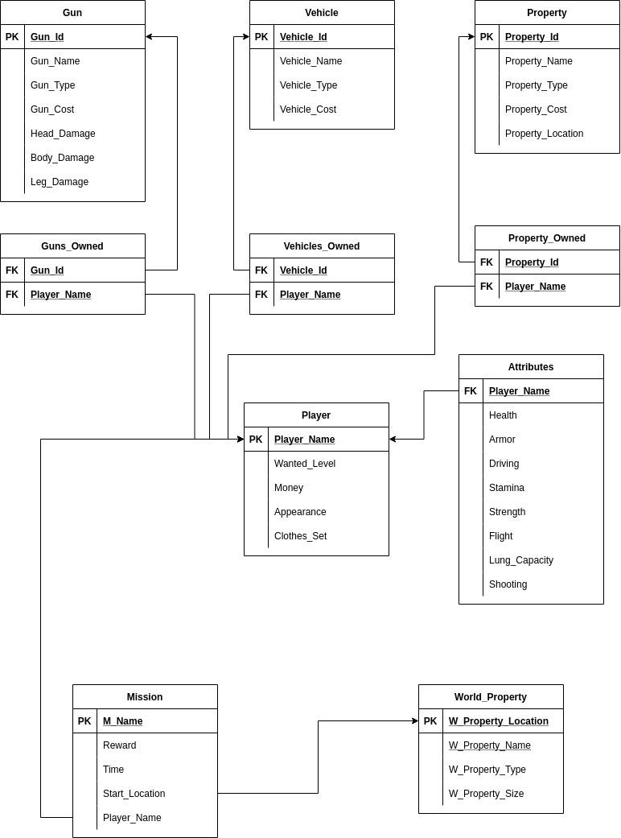
Schema

